Slide 1
Evergreen Insurance – Quoting Platform
Phase 3 Delivery Review & Stakeholder Demo
Ajit Ranjan Sahu | November 2026
Liberty Mutual Insurance | For Internal Use Only

Slide 2
Delivery Objectives
🎯 Modernize the Quote API
  REST and GraphQL endpoints with MongoDB-backed persistent storage
🎯 Demonstrate Cloud-Native Deployment
  Docker containerization and Kubernetes deployment capability​
🎯 Enable Web Delivery
  Static website hosting through Amazon S3
🎯 Ensure Delivery Quality
  Automated CI validation and reviewed green-code merge
For Internal Use only

Slide 3
Outcomes
✅ Quote API Complete
✅ MongoDB Integration Complete
✅ CI/CD Pipeline Complete
✅ Docker Image built and run complete
✅ Static website deployment to AWS S3 bucket Complete
✅ Kubernetes Validation Complete
✅ Deployed to Main Branch Complete
For Internal Use only

Slide 4
What Shipped
A fully functional website with Mongo DB storage
Docker Image creation and run from Docker container
Static website hosted on AWS S3 bucket
Repository: https://github.com/ajit5144/Evergreen_Capstone_Phase_3
S3 Website: Evergreen Insurance - Get a Quote
For Internal Use only

Slide 5
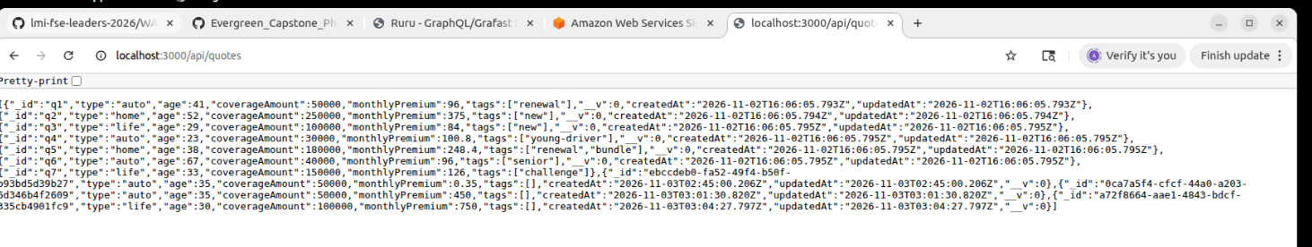
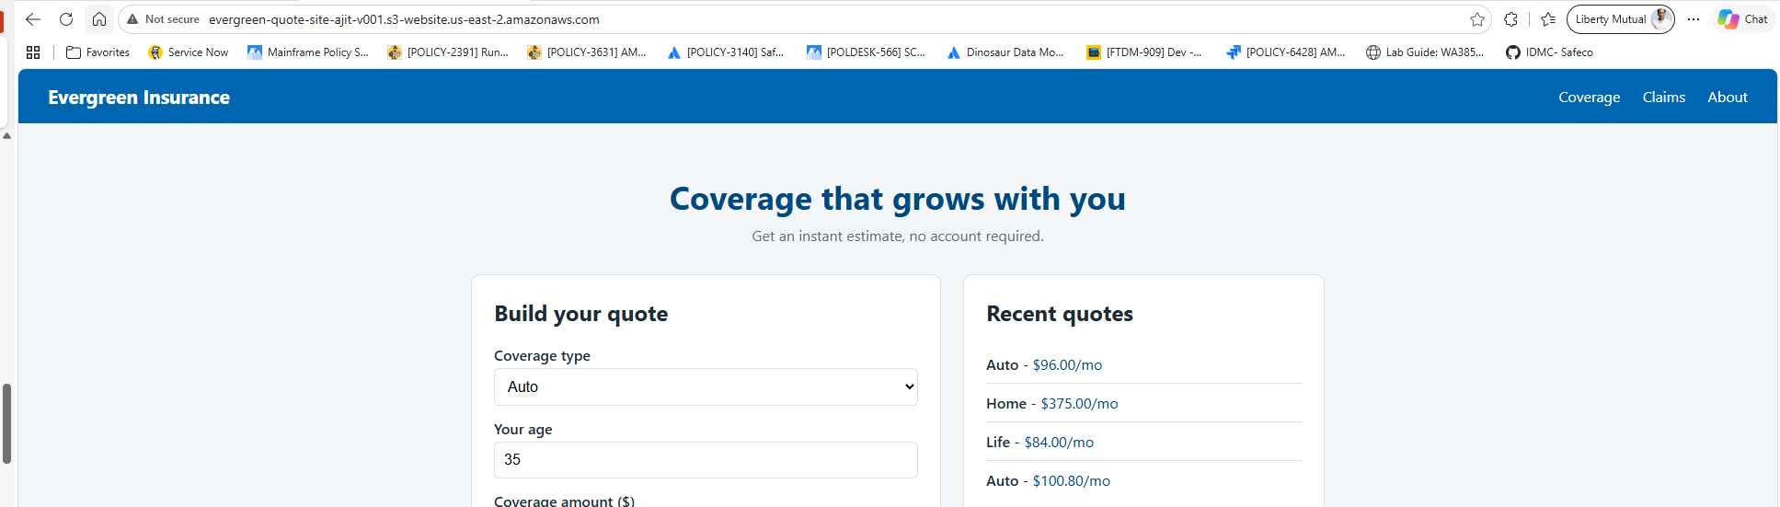
What Shipped..
For Internal Use only

Slide 6
Two Key Delivery Decisions
Decision 1: Sope Protection
Defer renters coverage
Why:
Protects the agreed delivery goal while allowing time to implement renters correctly.
Decision 2 : Release Governance
NO-GO for release merges and deployments during the simulated validation incident
Why:
Restoring customers’ ability to obtain accurate quotes takes priority over meeting the delivery schedule with an unverified release.
For Internal Use only

Slide 7
Risks & Injects
Priority​ | ID​ | Risk​ | Likelihood​ | Impact​ | Mitigation​
🔴​ | R2​ | Kubernetes startup/image loading impacts demo​ | M​ | H​ | Validate manifests, images, pods ready​
🔴​ | R1​ | Static site rates not aligned with API​ | H​ | M​ | Document limitation, roadmap integration​
🟡​ | R3​ | Seeded records mistaken for API defects​ | M​ | M​ | Explain seeded vs API-created records​
🟡​ | R5​ | Quote rate version not traceable​ | M​ | M​ | Track rate decisions and commits​
🟢​ | R4​ | Temporary cluster left running after demo​ | M​ | L​ | Delete kind cluster after demo​
For Internal Use only

Slide 8
What I Would Do Differently
Align scope and rates earlier:
  Confirm supported coverage types, sponsor-approved rates, and acceptance criteria at kickoff to reduce late changes.
Validate the deployment path sooner:
  Check repository paths, workflow dependencies, OIDC claims, and environment configuration before release week.
Strengthen release traceability:
  Record the tested commit, rate version, and deployed image so customer issues can be tied to the correct release.
Capture evidence continuously:
  Save test results, curl transcripts, PR links, and demo screenshots as stories close—not just before the stakeholder review.
For Internal Use only

